Slide 1
Behaviour management
Strategies for managing groups and individuals – top tips for behaviour management for teachers (and teacher trainers)!
Notes:
2.15pm

Slide 2
Causes of unwanted behaviour
ACTIVITY – solo - 90 seconds
Write down at least 5 possible causes of unwanted behaviour
We will share our ideas with the group
Notes:
2.17pm (90secs) write down 5 causes... Feedback on next slide

Slide 3
Causes of challenging behaviour
Notes:
2.25pm (5-10mins)

Slide 4
Behaviour issues
Activity at tables
SOLO: write down behaviour issues you have come across – think about your ITT trainees (60 seconds!)
PAIRS: share with a partner (2 mins)
GROUPS: share at your table (5 mins)
Identify one or two that you could focus on in a minute
Notes:
2.35pm - now think about the behaviour that causes issues in ITT....

Slide 5
In groups at your table (5 mins)
Organise the cards into these 4 categories
Rules and procedures
Teacher-student relationship
Disciplinary interventions
Mental set
Which strategies might you use?
- choose a strategy and consider how you could use it, or how you have seen it used.
Notes:
2.43pm (10min) 1st Feedback on the strategies – 1 example from each table/group (and the category it is from)
(NEXT SLIDES – the 4 categories)

Slide 6
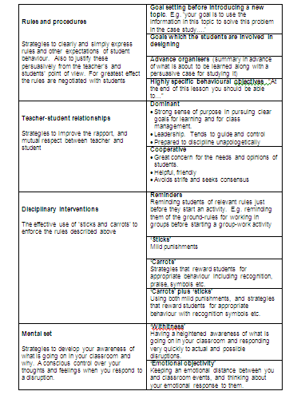

Slide 8
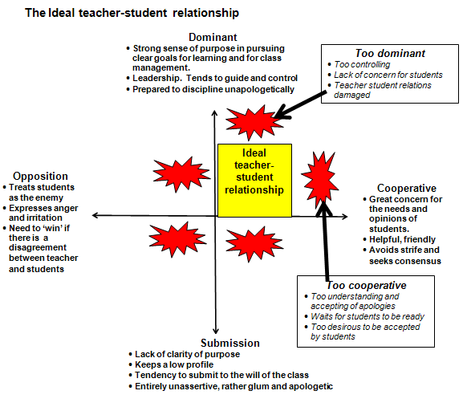
Notes:
2.55pm (10mins) - Issue Petty’s behaviour mgt chapter (downlaod)

Slide 9
Classroom management: Mary’s top 10 tips for teachers
Learn their names
Establish your expectations for behaviour (eg silence when you are speaking)
Negotiate ground rules
Get to know your learners and use their names (to praise as well as discipline)
Assume your formal authority – enforce rules eg health and safety
It is your classroom when you’re teaching– you can walk around it, rearrange it (or get learners to) and move learners around
Build your personal authority and personal rapport over time - show respect to earn respect
Create a working atmosphere (a positive learning environment)
Plan a well organised session that involves and includes everyone
Remember we all make mistakes, a professional teacher reflects and adapts!
Notes:
3.05pm (5mins) top tips shared

Slide 10
ACTIVITY
GROUP WORK (approx 10mins)
Produce your own top tips
– for teacher trainers!
Notes:
3.15pm (10mins) Top tips writing
(5mins) Share some top tips – favourite 1 from each table – for teacher trainers!

Slide 11
Useful resources
Cowley, S. (2006) Getting the Buggers to Behave. London: Continuum.
Cowley, S. (2006) Guerilla Guide to Teaching. London: Continuum. | P 53-55
Sue Cowley [online] | http://www.suecowley.co.uk/downloads.htm
Petty, G. (2004) Teaching Today 3rd edition. Cheltenham: Nelson Thornes | Chapter 8 p96-107
Geoff Petty [online] chapter on classroom management and discipline | http://www.geoffpetty.com/whatsnew.html
Teacher’s TV – Paul Dix profile (Video clip 3-4mins) | http://www.teachers.tv/behaviour/paul-dix-profile
Pivotal [online] | http://pivotaleducation.com/
Notes:
3.25pm Conclude with some resources

